Slide 1
Site Monitoring Refresher
Ensuring Continuous Quality Improvement
HIV Serology Diagnostics and Incidence
International Laboratory Branch
RTCQI Workshop – Cape Town
June 3-7, 2024
Notes:
Good morning everyone
For many of you this is a refresher
Quality is a crucial …
RTCQI is a key component for quality improvements in all PEPFAR supported testing sites and site monitoring is one of the important strategies used in the RTCQI program.
Continuous Quality improvement requires reassessing and addressing weaknesses across all quality system essentials. In order to these errors and weaknesses in you must have a mechanism to search for these errors. Quality assurance initiatives such as RTCQI, mentorship and training, are some initiatives that focus on quality management system development .

Slide 2
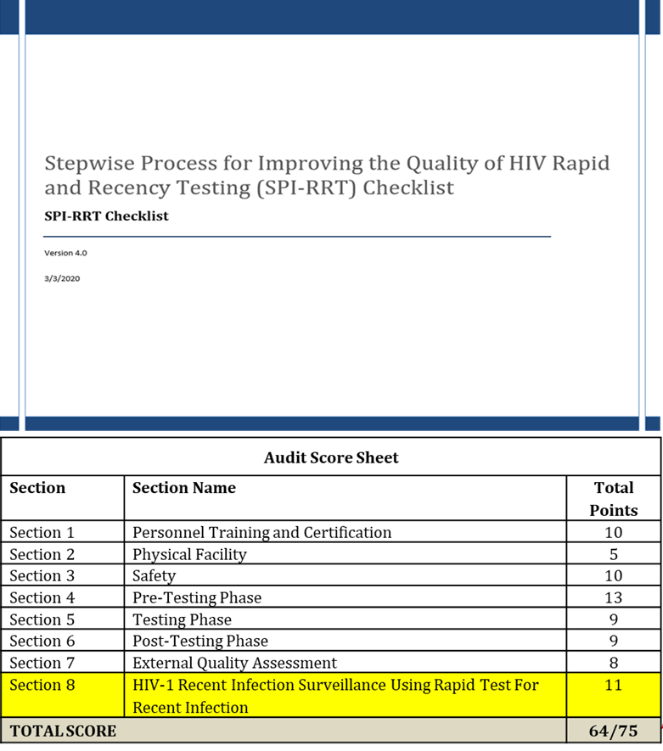
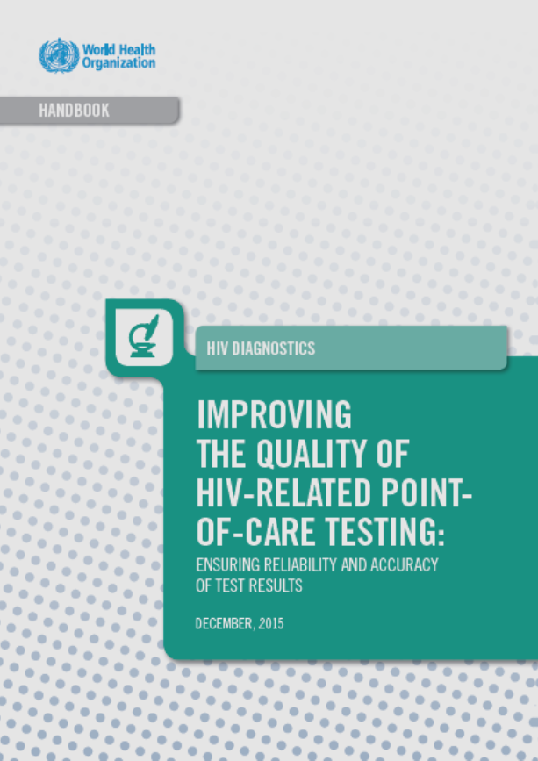
Stepwise Process for Improving the Quality of HIV Rapid and Recent Testing
S
Notes:
The SPI-RT checklist was developed and rolled out during implementation of RTCQI and accepted by WHO in 2015. It is included in their quality handbook, Improving the Quality of HIV related point-of-care-testing. This Checklist is one of the key pillars of RTCQI for certification of HIV rapid test sites
rddqio
The SPIRT checklist has been updated to include the requirements for recent infectiom survelliallance using

Slide 3
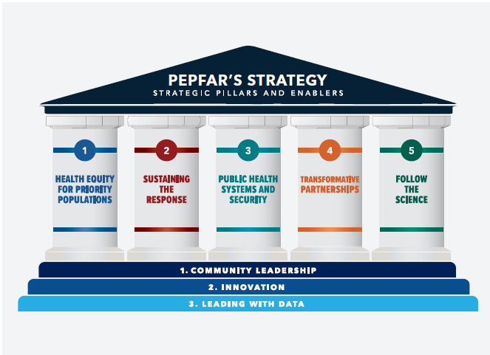
Stepwise Process for Improving the Quality of HIV Rapid and Recent Testing
S
SPI-RRT Checklist
Provides a solid foundation for ensuring the quality of testing
Serves as a tool to evaluate a site against quality standards required for improvement
Acts as a guide for development of policies and procedures to address gaps identified at the site
Notes:
The SPI-RRT Checklist is one of the pillars of RTCQI used to monitor quality compliance and certify HIV rapid testing sites
This checklist was designed to be used at resource limiting settings where HIV testing is being done to ensure the clients get accurate results. By applying this tool we can identify where the improvement is needed and once we identify these gaps we can develop action plans that will be used to implement the quality elements.. The SPIRT allows us to standardize how we assess the performance. Provides guidance for policy and procedure development.
systematic approach that includes development of appropriate policies, processes, and procedures around the quality of POCT should be adopted and a stepwise process including proper planning, implementation should be considered at all levels by national programs.
the degree to which health care services for individuals and populations increase the likelihood of desired health outcomes and are consistent with current professional knowledge.“
Assessments are done periodically.
Identify areas where improvement is needed
Develop and implement a work plan to address gaps
Implement quality assurance elements
Monitor quality progress
Maintain continuous quality improvement
As mentioned, the Ambassador is very keen on us supporting RTCQI as key components of quality improvements in al PEPFAR supported testing sites. That should be our message. Just talking about algorithm change or testing strategy without strong quality testing will not be helpful.

Slide 4
SPI-RRT Assessment Stages and Requirements
Identify sites
Notify sites & agree on assessment dates
Convey importance of the SPI-RT checklist
Familiarize yourself with the checklist
Pre - Assessment
Introduce assessment team to site management
Discuss purpose of assessment
Conduct assessment using the SPI-RT checklist
Assessment
Debrief with site management on findings & recommendations
File data at central facility
Post –Assess-
ment
Notes:
The audit is divided into three stages
Pre- assessment or planning phase – Sensitization meetings, document review checklists , making sure the persons have been informed identify sites
Implementation or assessment phase – Visit sites /Introductions, purpose of audit scope of the audit conduct the audits
Post audit – debriefs/ recommendations to appropriate persons site report

Slide 5
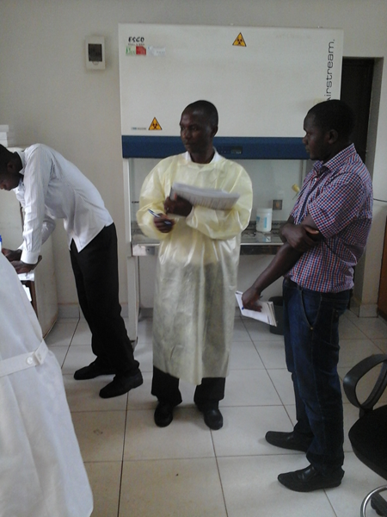
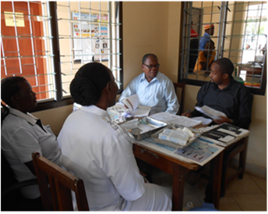

Site Audit Activities
Observe site operations
Dissemination of audit findings
Compile audit responses and summary of corrective actions into ODK tablet application

Slide 6


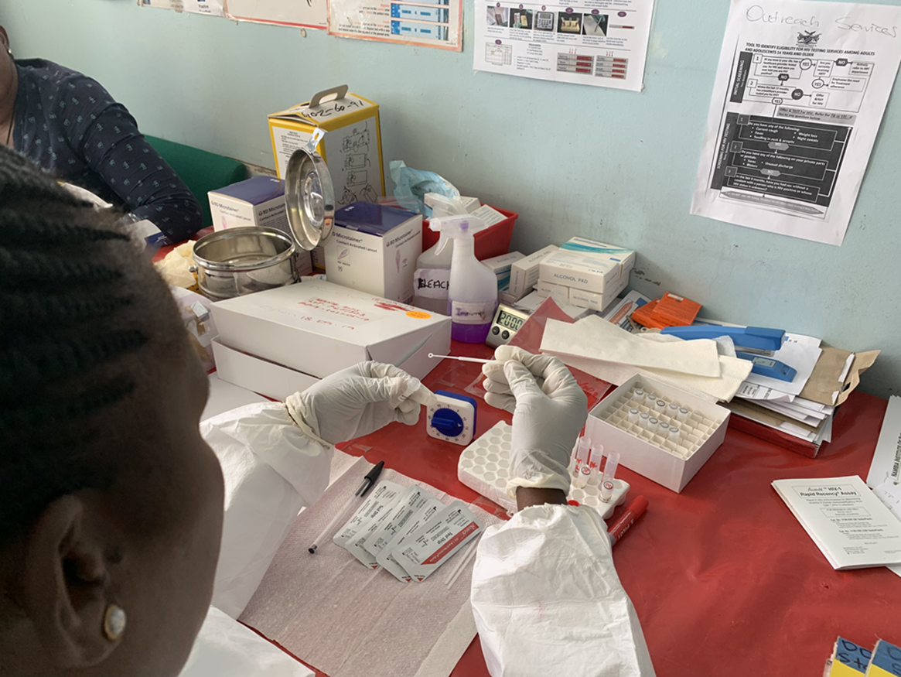

Site Assessment Methods
Records and Documents
Questions?
Direct Observations
Vertical/Horizontal Audits
Notes:
Review of the records I cover the entire period between assessments. Sampling three stages of records. Direct observation go when they are conducting test/ observe all aspects of testing techniques safety etc, Then there is asking questions ask open ended questions please describe how you would treat an invalid sample or a needle stick injury. Make sure you are asking the right questions to right persons. Show me tell me ask for evidence.
I usually use two types of audits horizontal audits.
Vertical audits will allow you to look at sample collection to result reporting you will look at the
- competency of staff
- Sample records
- Procedures used
- Quality control
- Maintenance records
- Environmental conditions
- Reliability of results
- Storage and disposal practices
From collection through accessioning, analysis, result verification, reporting, post-analytic handling and storage
Do vertical audits ask questions such as kindly explain how you would ensure the test kit is performing
Make sure you ask the correct person the questions I would usually establish this by asking who does the testing then verifying in the register that this is the person the goal is not to get the best answer but to ensure you capturing what really happens at the site
Follow up to a corrective corrective action I recommend you do a horizontal audit can be an excellent tool. If, in a previous audit, you found that the person doing the test did not have the annual competency done. Remember the CA should address the root cause and if this was effective then all competency records would be in place so on the follow up visit you look at all competency records is a good way to make sure that this is now done correctly.

Slide 7
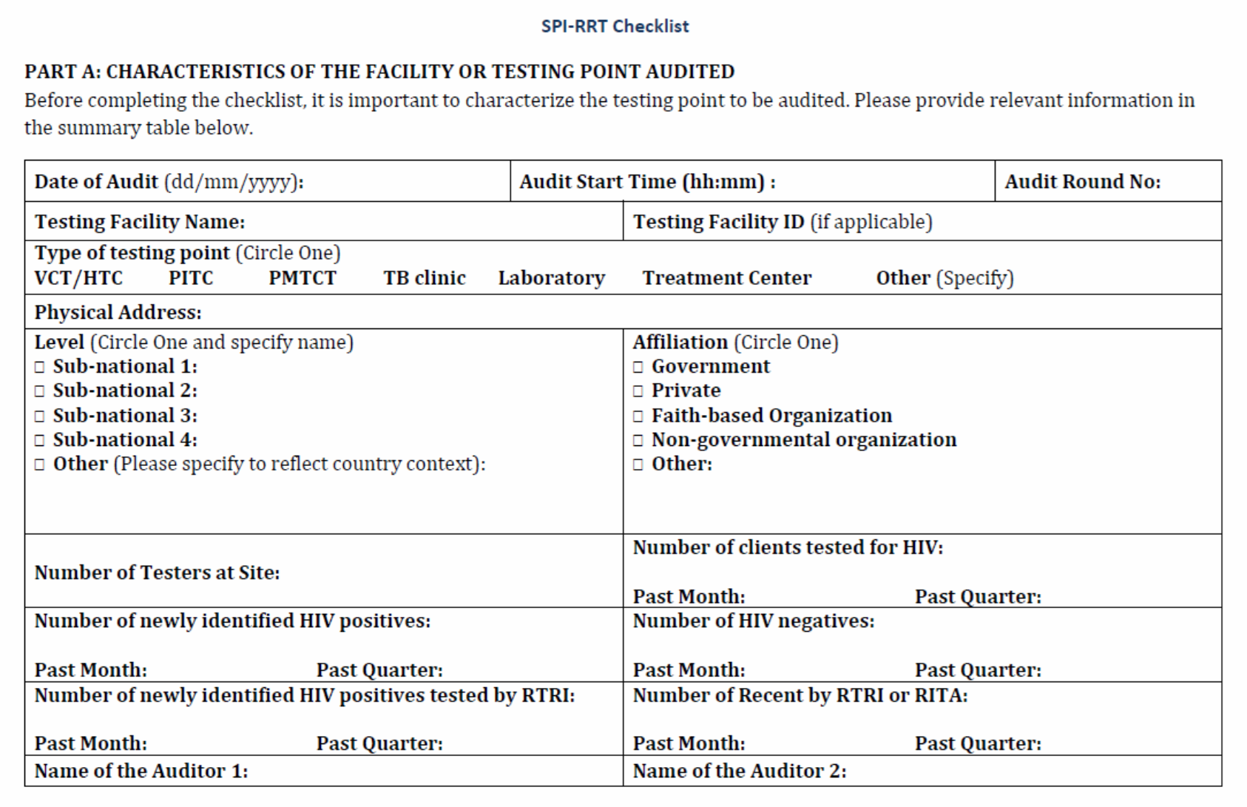
SPI-RRT Section Part A- Site Demographic Data
Notes:
Part A – used to collect demographic data of the site……go thru each section
At the bottom we are collecting testing data elements. We use this data to monitor data quality.

Slide 8
SPI-RRT Section Part B – Quality Standards
Personnel Training and Certification
HTS should be offered by testers with adequate and documented training, competent skills, and certified.
Physical Facility
The testing site is adequate to provide a safe and effective HTS services.
Safety
The testing sites implements infection prevention and control processes.
Pre-Testing
All safety and specimen collection procedures are followed, test kits and consumables are adequate to provide accurate and reliable test results
Testing
All safety and testing procedures are implemented during throughout testing
Post-Testing
Documents and procedures (SOPs/job aides) regarding reporting and reviewing results are implemented
External Quality Assessment
Testing sites are periodically audited for performance and Audited if quality assurance procedures are followed and documented
HIV-1 Recent Infection Surveillance
All safety and testing procedures for RTRI are implemented throughout the testing process
Notes:
These are the section standards for each component of the checklist
1- focus is on the competency of persons doing the test
2. Are the facilities adequate/lighting / space for storage of supplies etc.
3. Safety use of PPE /waste management availability of water for handwashing or hand sanitizers
4. Pretest SOPs / supply management
5. Testing are procedures followed / Is QC done and documented
6. Post test- documentation and security of the data
7. EQA proficiency testing Corrective actions and site monitoring
8. Requirement for HIV recent infection surveillance competency, supplies sops etc.

Slide 9
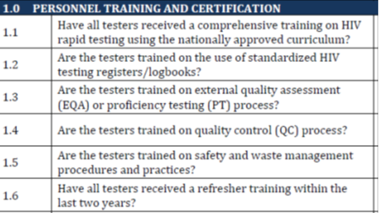
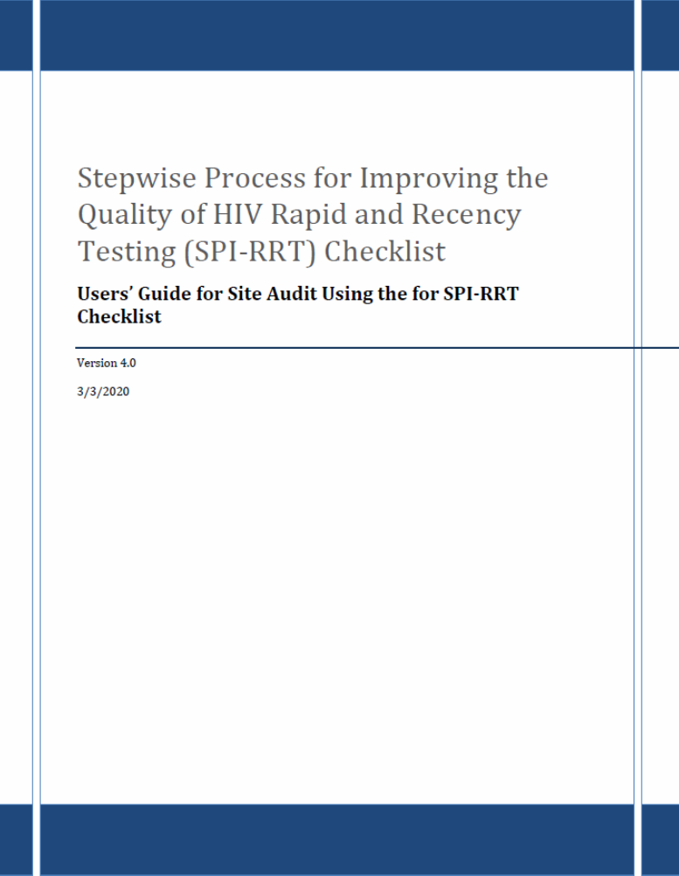
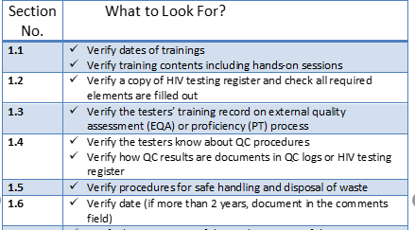
SPI-RRT User Guide
Guidance Quality Assurance practices at
HIV testing sites
Notes:
User guide to help standardize our scoring and base our corrective actions on a set of quality standards…. What should you look for it is objective evidence of a practice that is being described.
Yes = 1 point
When all elements are satisfactorily present
Partial = 0.5 points Some but not all elements present, inconsistent implementation or non-adherence to procedures
No= 0 point
No elements present
Provide comments for each “Partial” or “No” response.

Slide 10
SPI-RRT Checklist Part C- Site Scores
Audit Score Sheet
Section | Section Name | Total Points
Section 1 | Personnel Training and Certification | 10
Section 2 | Physical Facility | 5
Section 3 | Safety | 11
Section 4 | Pre-Testing Phase | 13
Section 5 | Testing Phase | 9
Section 6 | Post-Testing Phase | 9
Section 7 | External Quality Assessment | 8
Section 8 | HIV-1 Recent Infection Surveillance | 11
TOTAL SCORE |  | 64/75
Total score expected
64 if no RTRI testing
75 if RTRI testing
Notes:
The percent score obtained by the audited testing point will correspond to a specific performance level
This checklist consists of five different levels to indicate progress toward national site certification. What do these scores really mean and how do you translate them to actionable measures for CQI.
SPI-RRT Levels 0 and 1 monthly
Internal audits by POCT site personnel
Mentoring by facility lab staff, IPs, QA officers or quality mentors
SPI-RRT Level 2 Quarterly
Audits by sub-national team (regional or district level)
Mentoring by sub-national team including Q-corps
SPI-RRT Level 3 Semi annual
Audits by subnational team (regional or district)
Mentoring by sub-national team including Q-corps
Certified POCT sites
Internal audits by POCT site to ensure compliance and meet recertification eligibility requirements
SPI-RRT Level 4 Annually
Audits by certifying body
Initial certification
Certified POCT Site Biannually
Audits by certifying body
Recertification

Slide 11
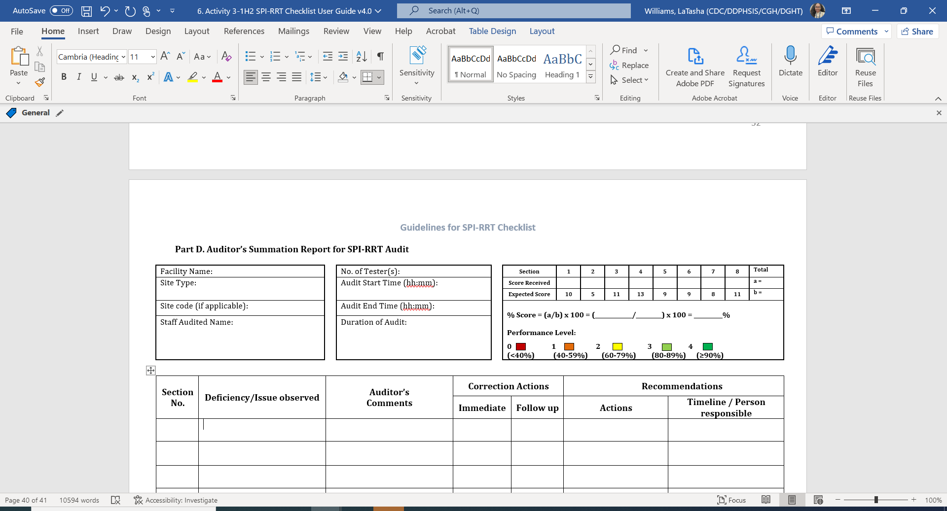
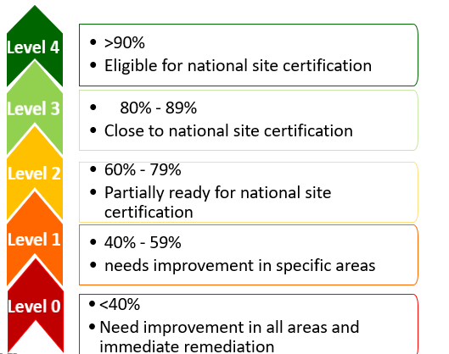
SPI-RRT Checklist Part D- Summary Report
Notes:
Information is provided to:
NRL and Program coordinators
Regional/District program coordinator
Facility managers
Quality Assurance officer
Head of testing sites
HIV rapid and recency testing sites personnel
Implementing partners
Can monitor impact over time
Summary sheet to be filled out at the site before the de-brief
Ideally 2 copies: 1 for site and 1 for auditors
Recorded Duration of Audit from start of in-brief to out-brief
Also record for each testing point the checklist auditing time
Indicate the correct pre-certification level obtained by the site

Slide 12
SPI-RRT Checklist Part D- Action Plan
Section No. | Deficiency/Issue observed | Auditor’s Comments | Correction Actions |  | Recommendations
 |  |  | Immediate | Follow up | Actions | Timeline / Person responsible
Question number
Can be corrected by site directly and quickly
From comments taken during audit
Corrective Action may need coordinator support
Any additional information from the auditor on the root cause of the issue
Suggested Corrective Action
Who can support corrective action:
Site,
HTS coordinator
HTS Program
Laboratory
NRL
Notes:
Opportunity for mentorship and coaching to address gaps
Immediate corrective action vs. Follow-up
Gaps that impact providing the right result to the client or the safety of the tester, client or environment
On site refresher training
Safety Practices
Proper blood collection
Test procedures
Documentation
HTS register
Data capture form or tablet ODK
Feedback = Opportunity for teaching moments
Knowledge is critical
National guidelines
Recency Protocol
Procedures on safety, testing, documentation, etc
Best practices, deficiencies observed
Corrective actions
Timelines
Point of contact for follow up
Scenario- Corresponds to question 5.3 and 5.4. Tester not using the correct specimen collection device for Determine rapid test. Additional information – stock out issue of capillary tubes. Corrective action – immediate. Recommendation action – onsite refresher training, timeline person responsible- auditor and person in-charge to observe testing for a period of time to ensure tester understood procedure and following it correctly, ensure that there is a system in lace to forcast the amt of capillary tubes needed and when to order to prevent future stock outs.
Provides a template for the corrective action report which is the difference between correction and corrective action

Slide 13


Road Map to Site Certification
Training of Auditors
Improvement plan
Site Certification
Baseline Audit
Follow up audits
Identification of sites and development of work plan
Regional sensitization and selection of sites
MOH Endorsement
Continuous Quality Improvement (CQI)
Notes:
Site certification
Provides recognition of technical competence
Gives confidence to users in availing the services
Site certification, including regular on-site supervision, mentoring and site audit, has been identified as an important method to meet and maintain quality in countries with growing numbers of rapid diagnostic and POCT sites. Likewise, provider certification along with standardized hands-on training and ongoing supervision and reassessment to ensure competency are critical to ensure accurate and reliable rapid diagnostic and POCT results. National site and tester certification can be used to verify that the site is equipped and personnel are competent to conduct testing per national and/or international established guidelines.
This will subsequently strengthen national capacity to protect the progress gained toward HIV/AIDS epidemic control and ensure preparedness for future pandemics. As an aspect of human capacity building, laboratory testing staff, managers,

Slide 14

Leading the fight to eliminate HIV and AIDS as a global health threat by 2030
THANK YOU

Slide 15
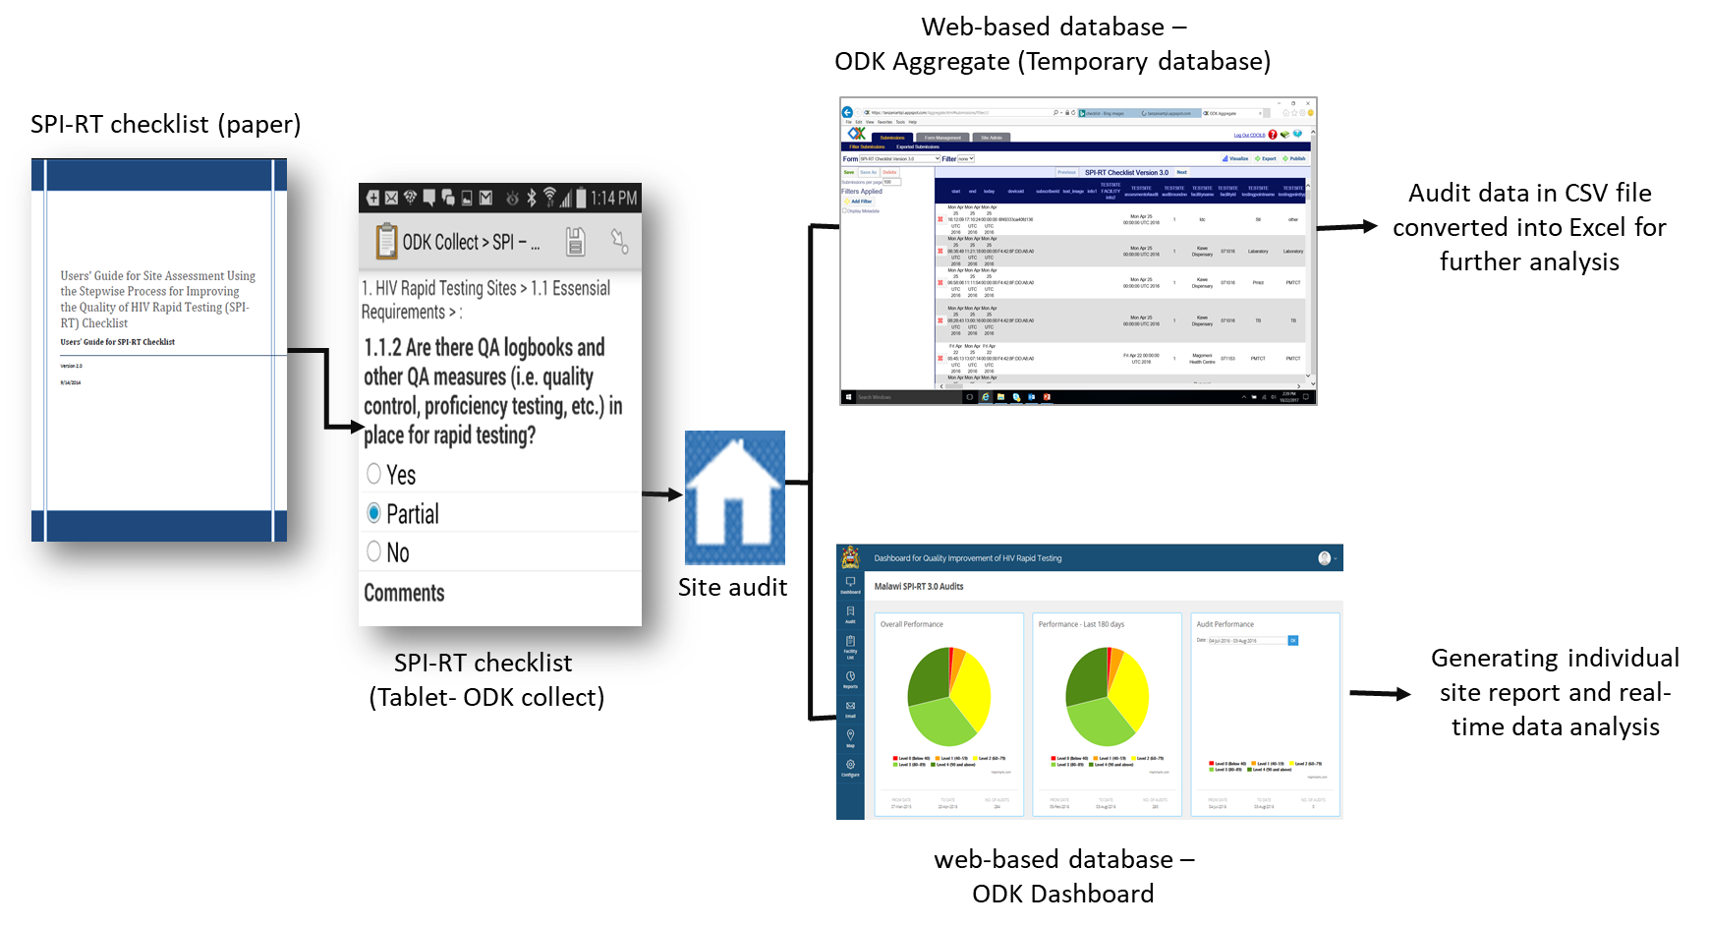
SPI-RT/SPI-RRT Audit Tools
Notes:
This is the additional that makes the management of the program more efficient and by improving this opportunities for improvement can be identified and correctiv
e actions provided to close these gaps

Slide 16
Road Map to Site Certification
Training of Auditors
Strengthening local capacity to scale-up nationally
Improvement plan
Site Certification
Baseline Audit
Follow up audits
Identification of sites and development of work plan
Regional sensitization and selection of sites
MOH Endorsement
Advocating for integration into national QA/QI framework and leveraging resources for CQI
Corrective action plan – refresher training, leveraging resources to address certain gaps, etc.
Corrective actions are implemented. Sites are in compliance to the QA standards
- All sites performing HIV RT and RTRI testing
- Phased implementation
- Regional level buy-in
- High volume
- High prevalence
Where are the gaps? Are sites following basic QA practices?
Positive impact of onsite mentorship and coaching
Continuous Quality Improvement (CQI)
Completing the Quality Assurance Cycle (QAC) at sites
Notes:
Advocate for resurces
Phased implementation identify all sites
Select sites regional
Conduct audits look for gaps
Developm action plan need to make sure resources are available
Do follow up audits
Site certification
Facilitates the implementation and maintenance of an effective quality management system • Gives confidence to users in availing the services • Gives confidence to the site and user for the results generated • Provides recognition of technical competence • Helps in defending site while dealing with legal disputes pertaining to results
As access to POCT expands in low- and middle-income countries, there is a need for simple, practical and low cost innovative approaches to ensure sustainable quality assurance practices that lead to accurate and reliable patient results and improved public health outcomes
There is now a growing need for innovative methods and practices to assist testing sites and tester with the improvement and maintenance of quality, while leveraging existing resources. Thus, national certification programs for POCT sites and testers would be an innovation by providing clinical governance to support health care providers involved in testing. The clinical governance would allow health-care providers to be accountable for continuing to improve the quality of the POCT service and safeguarding high standards of care by creating an environment in which excellence in clinical care can flourish. The implementation and the maintenance of a POCT site and tester certification will add credibility to any testing site, provides means to ensure and monitor adherence to quality standards and instill confidence in the results for patient care.
Site certification, including regular on-site supervision, mentoring and site audit, has been identified as an important method to meet and maintain quality in countries with growing numbers of rapid diagnostic and POCT sites. Likewise, provider certification along with standardized hands-on training and ongoing supervision and reassessment to ensure competency are critical to ensure accurate and reliable rapid diagnostic and POCT results. National site and tester certification can be used to verify that the site is equipped and personnel are competent to conduct testing per national and/or international established guidelines.
This will subsequently strengthen national capacity to protect the progress gained toward HIV/AIDS epidemic control and ensure preparedness for future pandemics. As an aspect of human capacity building, laboratory testing staff, managers, and 10 | P a g e supervisors will benefit from PEPFAR supported training opportunities that position them to effectively lead in the prevention, detection, and control of diseases.

Slide 17
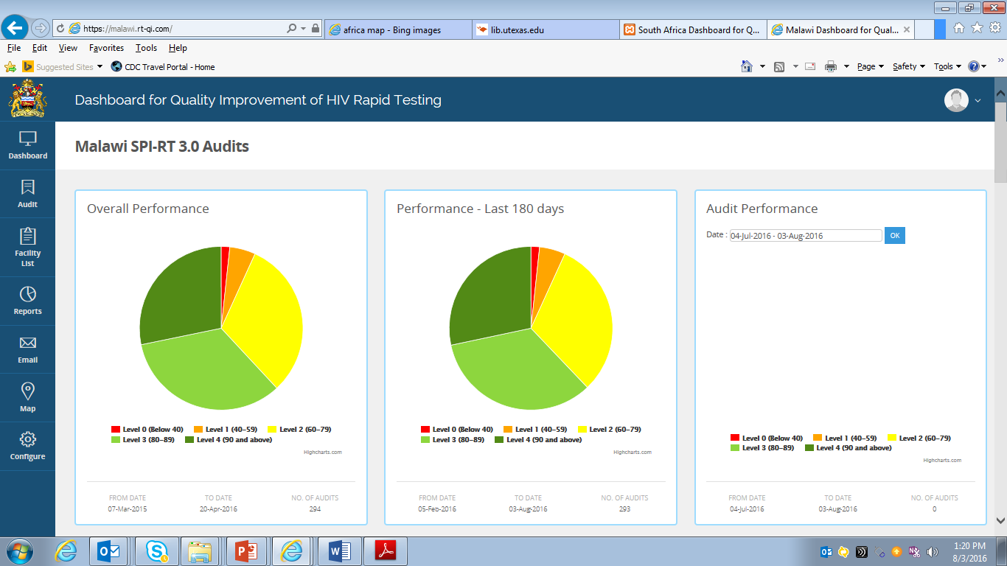
Real-time Access to SPI-RT Site Audits Data
Notes:
Site unique Id and make a calendar of evens of assessments

Slide 18
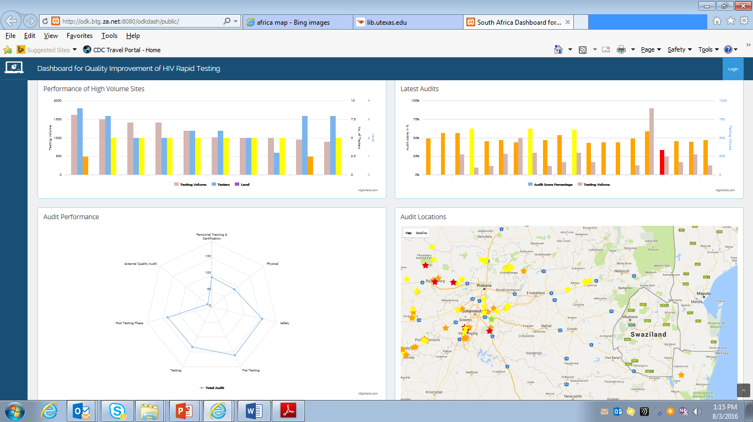
Real-time Access to SPI-RT Site Audits Data

Slide 19
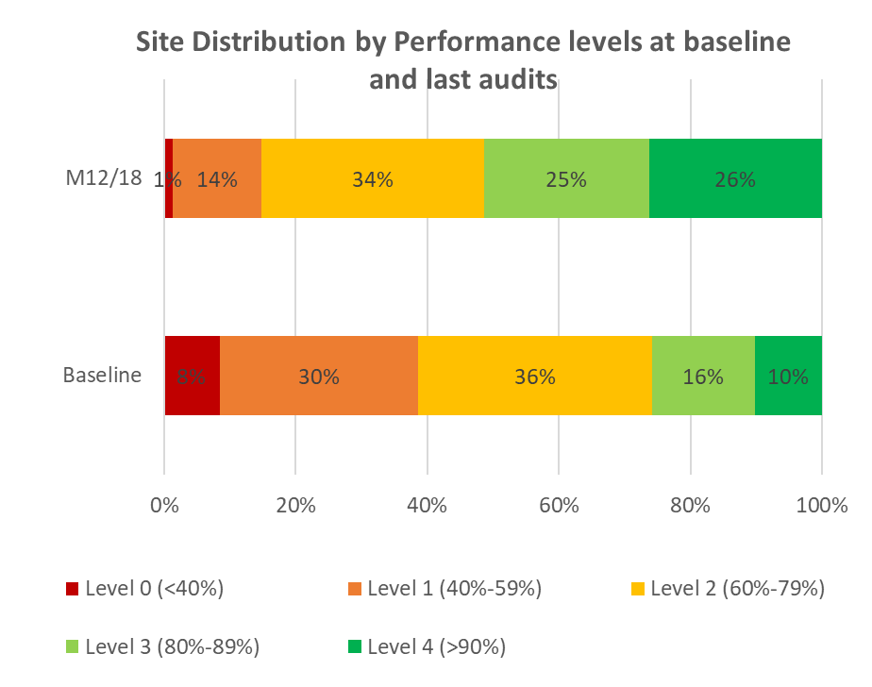
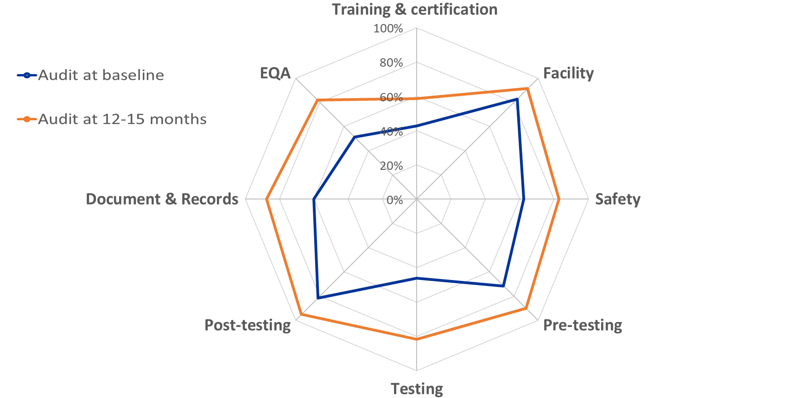
Sites Audit Data from Baseline to Last Audit

Slide 20
Quality Assurance Cycle
Provides means to prevent, detect and correct errors
Ensures quality data for targeted response
QAC
Site Monitoring
Plan
Monitor
Evaluate
Collect data
Improve
Define
Implement
Train monitors/ auditors
Conduct site monitoring
Role & Responsibility
Requirement
Review & analyze
Identify gaps
Identify root causes
Provide feedback
Corrective action plan
Establish monitoring team(s)
Develop tools
Notes:
The quality assurance cycle governs the implementation of all quality improvement initiatives and allows for improvement with continuous monitoring.
Baseline data is collected, followed by an action plan to develop interventions with the expectation that quality will indeed improve with close monitoring and dedicated action. Subsequent follow-up visits will then be used to measure and assess any actual quality improvements.
It is important that while you address the individual components that there is the engagement of management at all stages.
At the planning phase engaging leadership, establishing national QA coordination team, defining roles and responsibilities, reviewing and developing QA, financing, and staffing policies
Implementation through training and certification of test providers, site accreditation, supportive supervision, adequate quality/process control, documentation/record-keeping and ensuring a robust supply chain.
Monitor/Feedback/Improve – evaluating quality through audits, using data for decision-making, making improvements, undertaking advocacy and communication, and increasing ownership

